Slide 1
Environment and competitiveness: friends or foes?
Nicola Cantore
24/08/2018

Slide 2
Structure of the presentation
1. Why are emissions reduction and environment protection often perceived as constraints to industrialization and growth?
2. Why are emissions reduction and environment an opportunity for industrialization and growth?
3. Conclusions

Slide 3
1. Why are emissions reduction and environment protection often perceived as constraints to industrialization and growth?

Slide 4
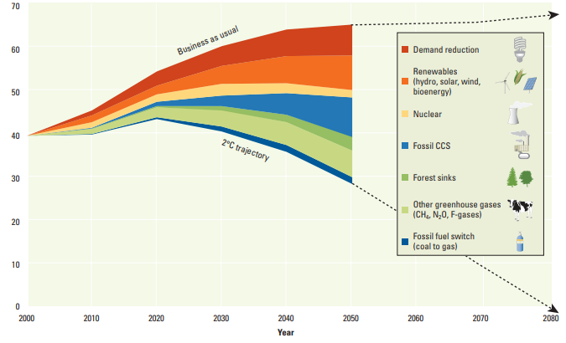
Emissions reduction requires many options
Co2e (Gigatons)
World Development Report 2010

Slide 5
There is ample evidence that environmental regulations induce innovation activity in cleaner technologies, but the benefits brought forward by these innovations do not seem to be high enough to outweigh the costs of regulations for the regulated entities
Dechezleprêtre and Sato, 2017

Slide 6
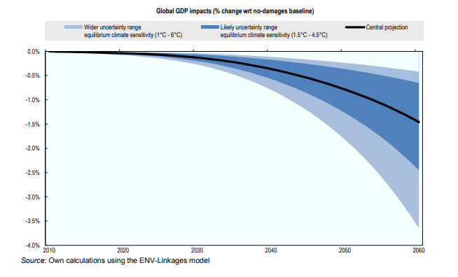
Reduction of emissions is normally perceived as a cost for economies…
Source: OECD 2014

Slide 7
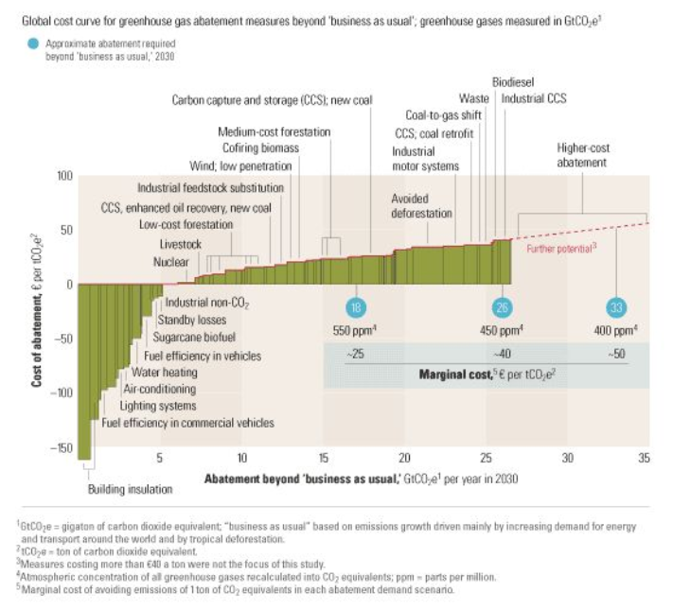
…especially for ambitious emissions reduction targets
Source: McKinsey 2009

Slide 8
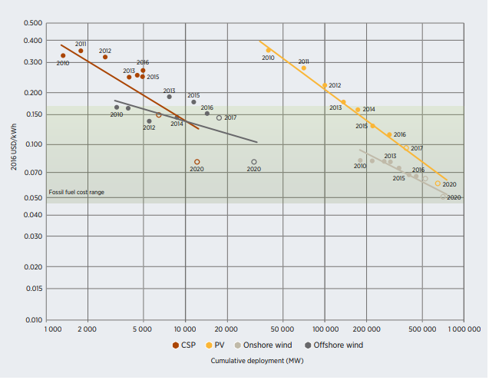
Renewable energy is often perceived as a costly option
By 2020, all the renewable power generation technologies that are now in
commercial use are expected to fall within the fossil fuel-fired cost range
Source: IRENA 2017

Slide 9
2. Why are emissions reduction and environment an opportunity for industrialization and growth?

Slide 10
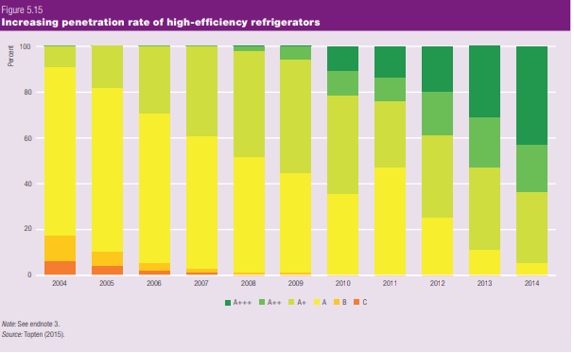
Argument 1: On the consumption side environmental goods can attract the preferences of consumers
UNIDO Industrial Development Report 2018

Slide 11
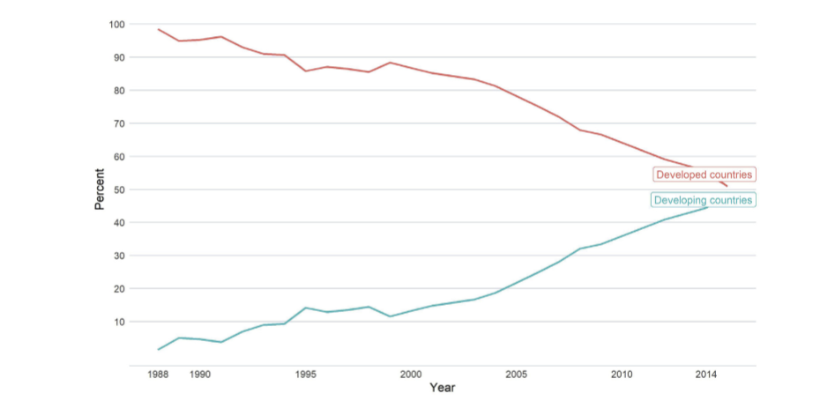
Argument 2: On the production side emissions reduction and environment protection require the production and exports of environmental goods
UNIDO Industrial Development Report 2018
Cantore et al. (2018) find that environmental taxes reduce imports of environmental goods and increase domestic production

Slide 12
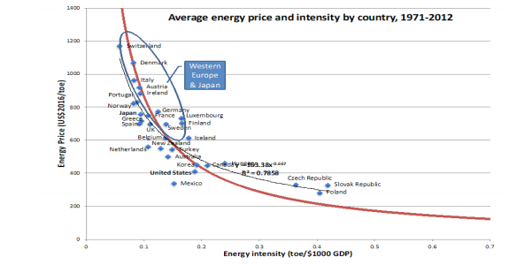
Argument 3: High energy prices generate low energy intensity
Response of total factor productivity to higher energy efficiency
Grubb et al. 2017

Slide 13
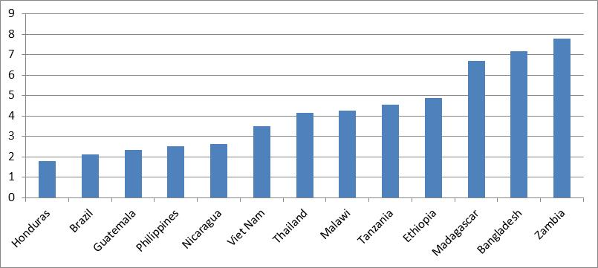
Argument 3: … Low energy intensity means high total factor productivity…
Response of total factor productivity to higher energy efficiency
Cantore et al. 2016, Energy Policy

Slide 14
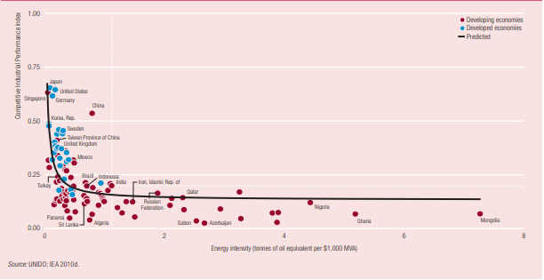
Argument 3: … and Low energy intensity means more competitiveness
UNIDO Industrial Development Report 2011

Slide 15
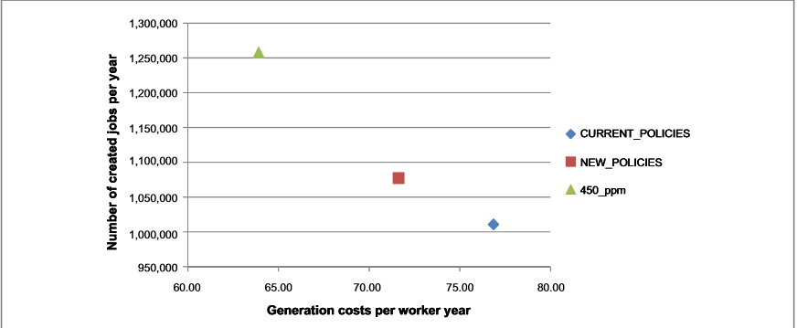
Argument 4: Greening electrification creates jobs with a lower generation cost per worker
Source: Cantore et al. 2017, study on Africa, Environmental Research Letters
Generation costs in thousands 2011 USD

Slide 16
A joint collaboration between World Bank and UNIDO generated preliminary empirical findings contained in the forthcoming World Bank report “Fiscal policies for development and climate action”

Slide 17
3.Conclusions
Environmental and energy policies are not necessarily rivals of industrial policy, they should rather be mainstreamed into it
When environmental and energy policies objectives cannot be fully reconciled with growth and industrialization, accompanying measures may be needed to mitigate the effects on competitiveness
In evaluating environmental and energy policies, policy makers should also take into account social benefits which are not captured by market analyses

Slide 18
Thanks!

